Slide 1
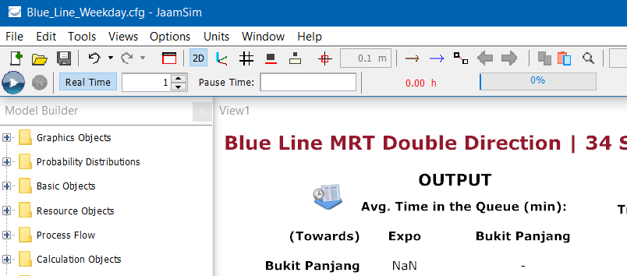

Simulation Run (RECAP)
We declared the following attributes for the Simulation Object in the cfg file of the models.
Each model cycle has a SimTime duration of 24 hours, while the train operations are from SimTime: 05 h to 24 h.
In addition, the number of replications is currently set to 2. Hence after pressing the “Run” button, the simulation will run once first and then reset automatically and run again for a second time.
For this Output Analysis we will be increasing the number of repetitions to 100 to provide a better overall estimate after averaging.
40.015 Simulation Modeling and Analysis | Mass Rapid Transit System Line Simulation

Slide 2
Common Random Number
To reduce the variance in our results such that any observed differences between models (if any) is due to the different configurations and not random conditions.
JaamSim uses the same default GlobalSubstreamSeed in the Simulation Parameters since the GlobalSubstreamSeed is not specified.
Hence this uses the same Global Seed for the different .cfg models.
40.015 Simulation Modeling and Analysis | Mass Rapid Transit System Line Simulation

Slide 3
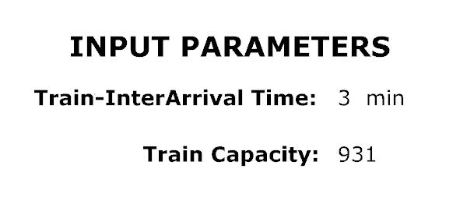
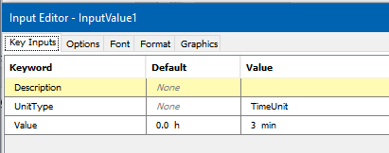
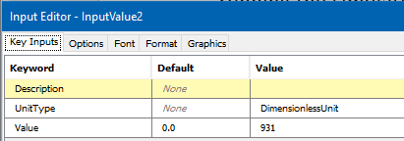
Input Parameters (RECAP)
The Train Interarrival time are parameters that are adjustable by the user before running the simulation using “InputValue”.
Similar for Train Capacity which is set to the current maximum capacity of a medium-capacity MRT line.
40.015 Simulation Modeling and Analysis | Mass Rapid Transit System Line Simulation

Slide 4
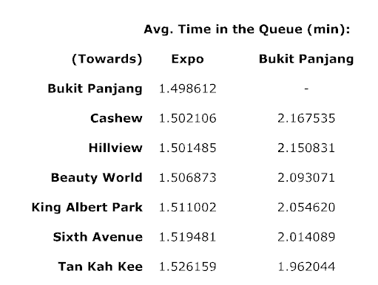
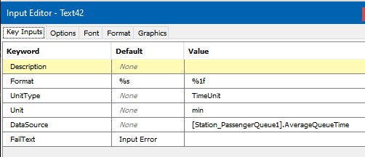
Output Table
The average times in minutes a passenger stays in the queue for every station in the direction specified.
40.015 Simulation Modeling and Analysis | Mass Rapid Transit System Line Simulation

Slide 5
Output Analysis 1
Control run:
Using parameters obtained from collected data (04 Data Collection and Manipulation).
2 Runs: Weekdays and Weekends (Note each run simulates the time for 1 actual day).
In order to get better estimates for the results, each simulation will be repeated 100 times before averaging.
We want to simulate and visualize:
What happens to average time spent in passenger queue if safe-distancing measures are enforced in MRT trains;
Intuitively, the average time should not change if the MRT capacity is still sufficient.
This is done by running the simulations (also 100 repetitions and averaged) and with a lower train capacity (half), and then analyzing the average waiting time of each station against the control run.
40.015 Simulation Modeling and Analysis | Mass Rapid Transit System Line Simulation

Slide 6
Output Analysis 2
Control run:
Same control run results used.
We want to simulate and visualize:
How does decreasing the interarrival times of trains leaving the depot help to decrease the average waiting time in the queues?
This is done by running the simulations (similarly 100 repetitions and averaged) with a lower train interarrival time, and then analyzing the average waiting time of each station against the control run.
40.015 Simulation Modeling and Analysis | Mass Rapid Transit System Line Simulation

Slide 7
Visualization - Weekday
Decrease Train Capacity:
Similar average waiting time to control.
Decrease Train Interarrival Time:
Lower average passenger waiting times.
Note only 1 direction is being shown.
To view the animation, use the link in the html page.
40.015 Simulation Modeling and Analysis | Mass Rapid Transit System Line Simulation

Slide 8
Visualization - Weekend
Decrease Train Capacity:
Similar average waiting time to control.
Decrease Train Interarrival Time:
Lower average passenger waiting times.
Note approximately similar results were observed for both weekend and weekday.
40.015 Simulation Modeling and Analysis | Mass Rapid Transit System Line Simulation

Slide 9
Performances of Systems
Pairwise t-tests (Control vs Alternative):
Control vs Lower Train Capacity (Covid Period) for Weekday;
Control vs Lower Train Capacity (Covid Period) for Weekend;
Control vs Lower Train Interarrival Timing for Weekday;
Control vs Lower Train Interarrival Timing for Weekend.
Compared the expected performance measure (daily average waiting time) across 100 simulations (100 days) between the two systems for the 4 cases above.
Identified the 95% level confidence interval of the difference (Control Mean – Alternative Mean), between the expected performance of the 2 systems.
40.015 Simulation Modeling and Analysis | Mass Rapid Transit System Line Simulation

Slide 10
Pairwise t-test Results
Control vs Lower Train Capacity (Covid Period) for Weekday:
95% CI = [0,0]
Control vs Lower Train Capacity (Covid Period) for Weekend:
95% CI = [-0.000122246, -0.000111014]
-1
0
0.5
1
Control vs Lower Train Interarrival Timing for Weekday:
95% CI = [0.4818314, 0.4821723 ]
Control vs Lower Train Interarrival Timing for Weekend:
95% CI = [0.4844047, 0.4845710]
40.015 Simulation Modeling and Analysis | Mass Rapid Transit System Line Simulation

Slide 11
Pairwise t-test Results
Control vs Lower Train Capacity (Covid Period) for Weekday:
No significance difference in performance
Control vs Lower Train Capacity (Covid Period) for Weekend:
No significance difference in performance
-1
0
0.5
1
Control vs Lower Train Interarrival Timing for Weekday:
Alternative has better performance (lower waiting time)
Control vs Lower Train Interarrival Timing for Weekend:
Alternative has better performance (lower waiting time)
40.015 Simulation Modeling and Analysis | Mass Rapid Transit System Line Simulation

Slide 12
Reflection
In all our simulation runs, there were no occasions where passengers were unable to board the train due to full capacity. Perhaps we could reduce the proportion of passengers exiting.
With that said, this simulation model would be useful for countries planning to build a subway system as having to test these different trains capacity and arrival frequencies in real life would be costly and unpractical.
They could build their own system with our model and simulate what train capacity and arrival frequencies are necessary to obtain a target average passenger waiting time, given some estimate for passenger arrivals.
40.015 Simulation Modeling and Analysis | Mass Rapid Transit System Line Simulation

Slide 13
Model Extensions
Possible Extensions and Improvements to the Model:
Distinct passenger interarrival rates for each station and direction given more detailed data.
Passenger departures to follow a certain distribution instead of constant proportion.
More complex models extending from basic model:
Split tracks
Consider passenger arrivals from other lines at connecting station.
Consider downtime entities in JaamSim (breakdown disruptions or signaling faults).
All stated improvements require more data to determine the parameter values and distributions.
40.015 Simulation Modeling and Analysis | Mass Rapid Transit System Line Simulation

